Slide 1
Project Overview: Machine Learning-based Attack Detection in Structural Health Monitoring Wireless Sensor Networks (SHM WSN)
Group Coordinator : Jeevan Kumar Banoth
Group members : Jeevan Kumar Banoth, Pulkit Kalra, Samuel D Guillaume, Namratha Sumeda

Slide 2
Summary:
1 – Introduction
2 – Data processing and feature engineering
3 – Model development and training
4 – Real-world application design
5 – Conclusion and future work

Slide 3

1- Introduction:
Project Overview

Slide 4
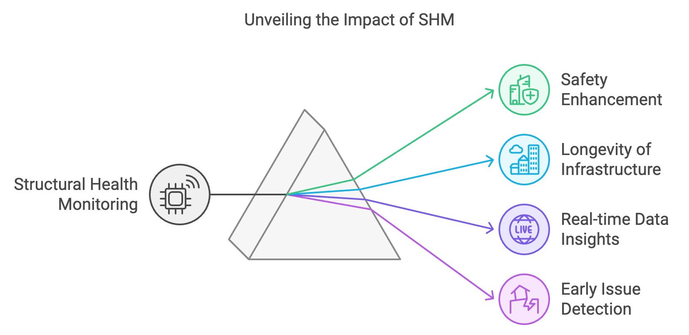
1- Introduction:
Goals and Objectives

Slide 5
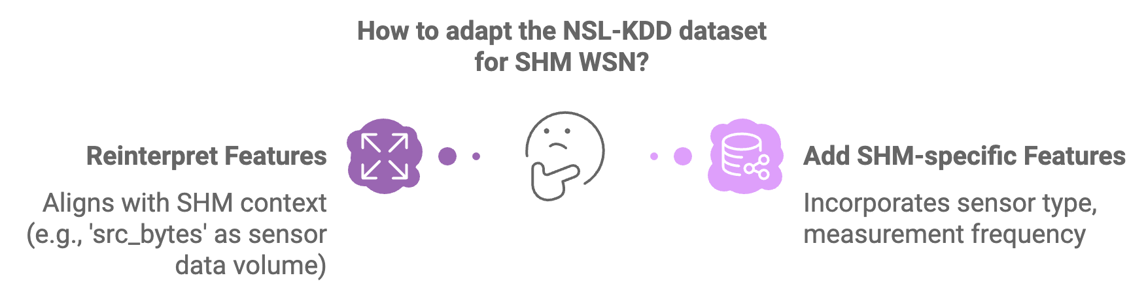
2- Data processing and feature engineering :
Data acquisition

Slide 6
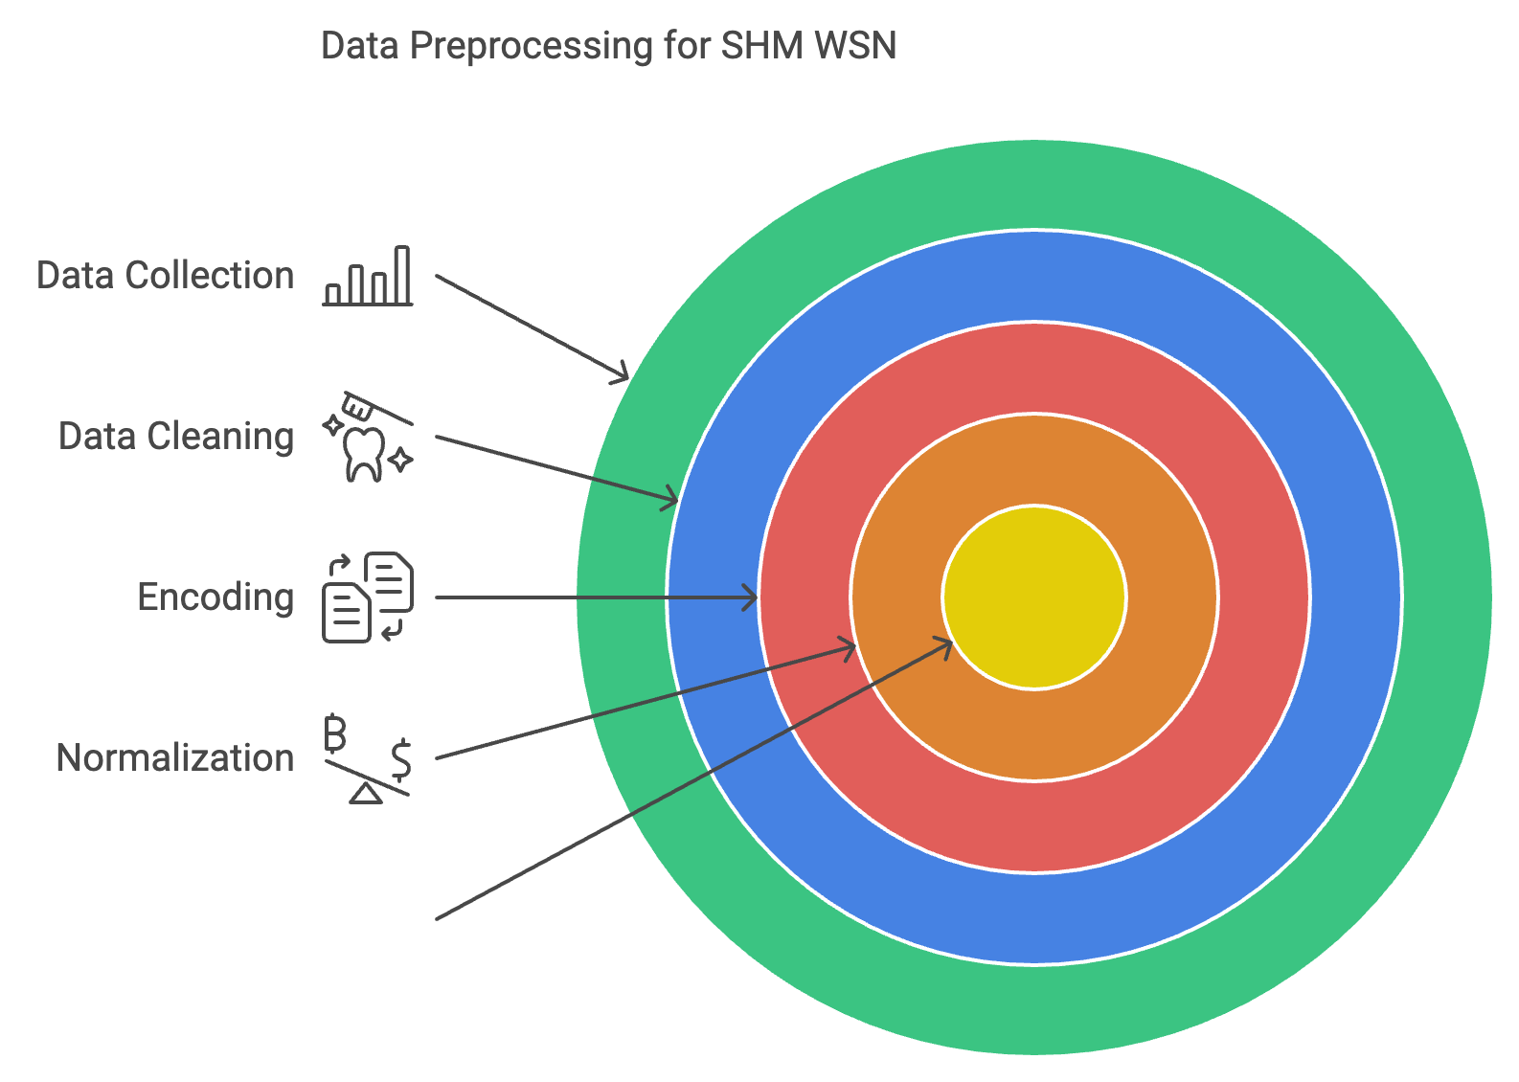
2- Data processing and feature engineering :
Preprocessing and cleaning

Slide 7
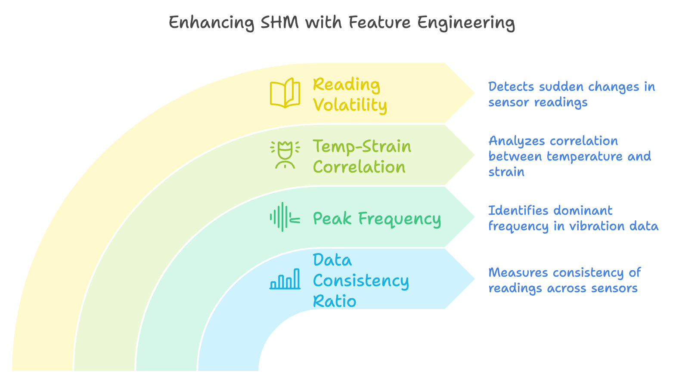
2- Data processing and feature engineering :
Feature creation and engineering

Slide 8
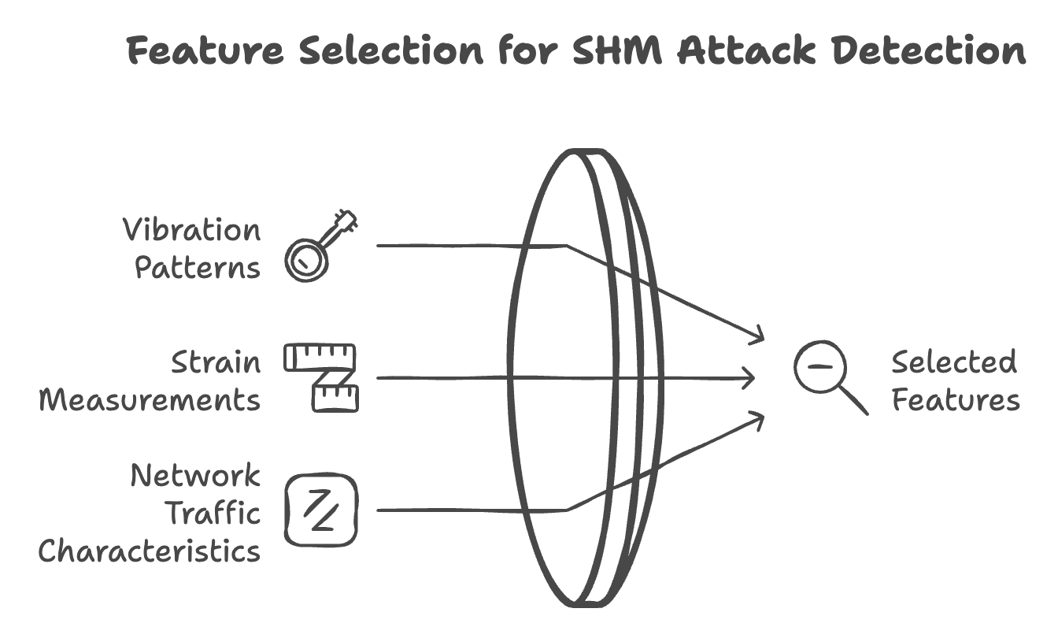
2- Data processing and feature engineering :
Advanced feature selection techniques

Slide 9
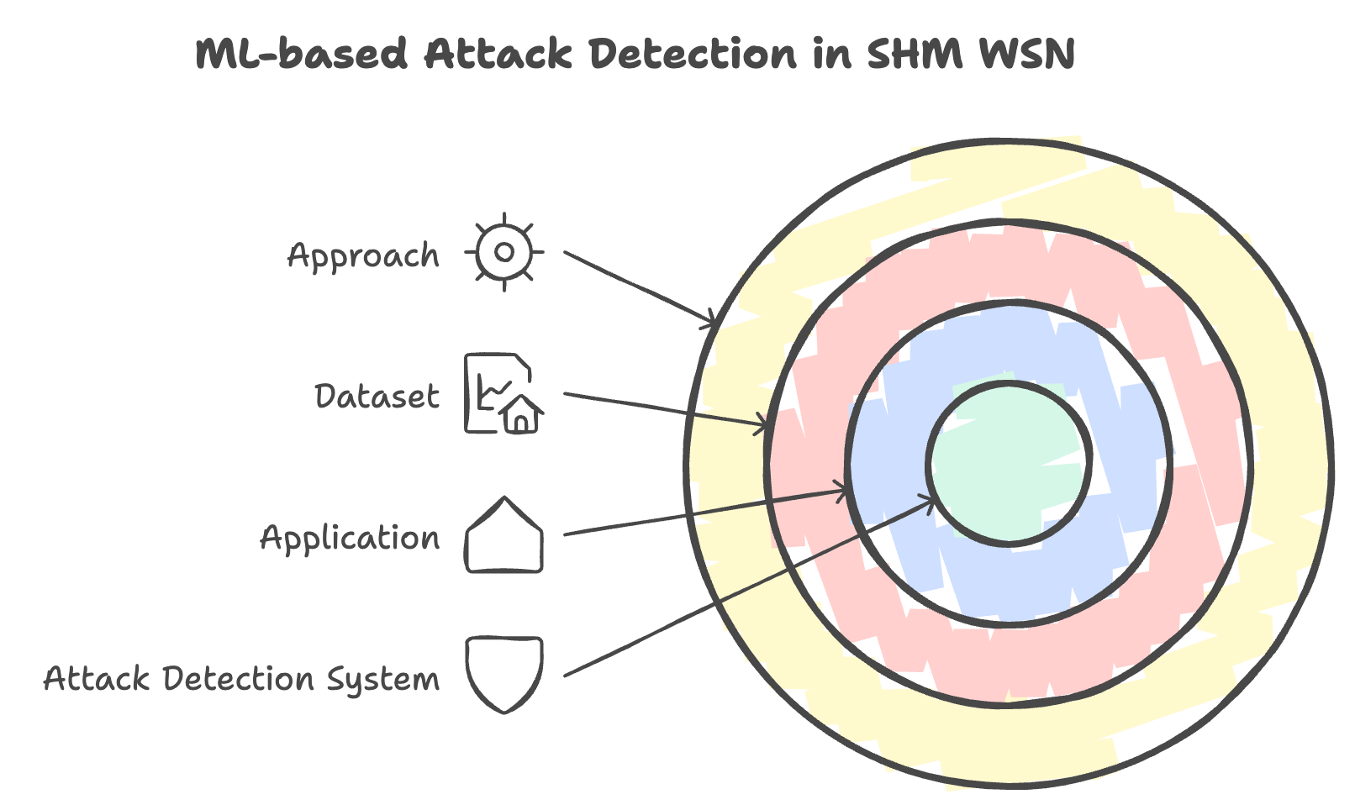
3- Model development and training

Slide 10
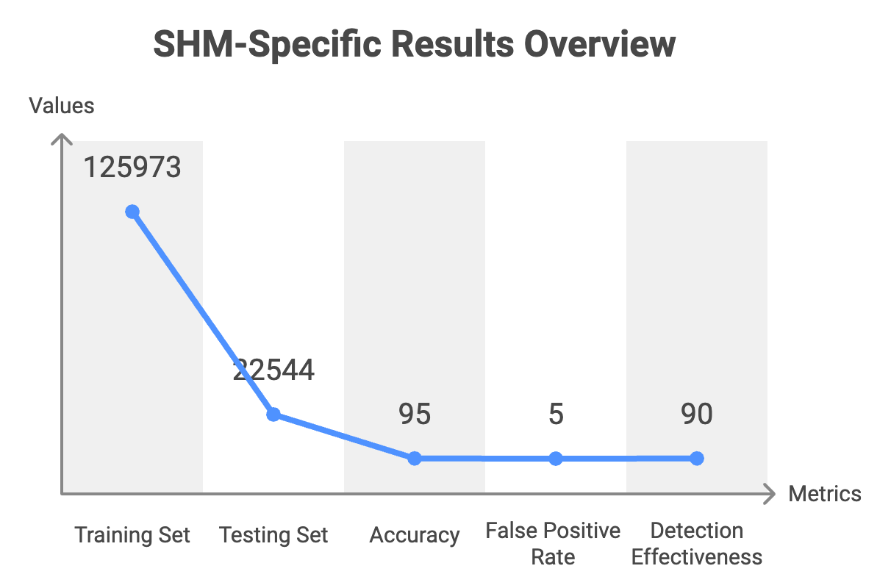
3- Model development and training
Training

Slide 11

4- Real world application design

Slide 12
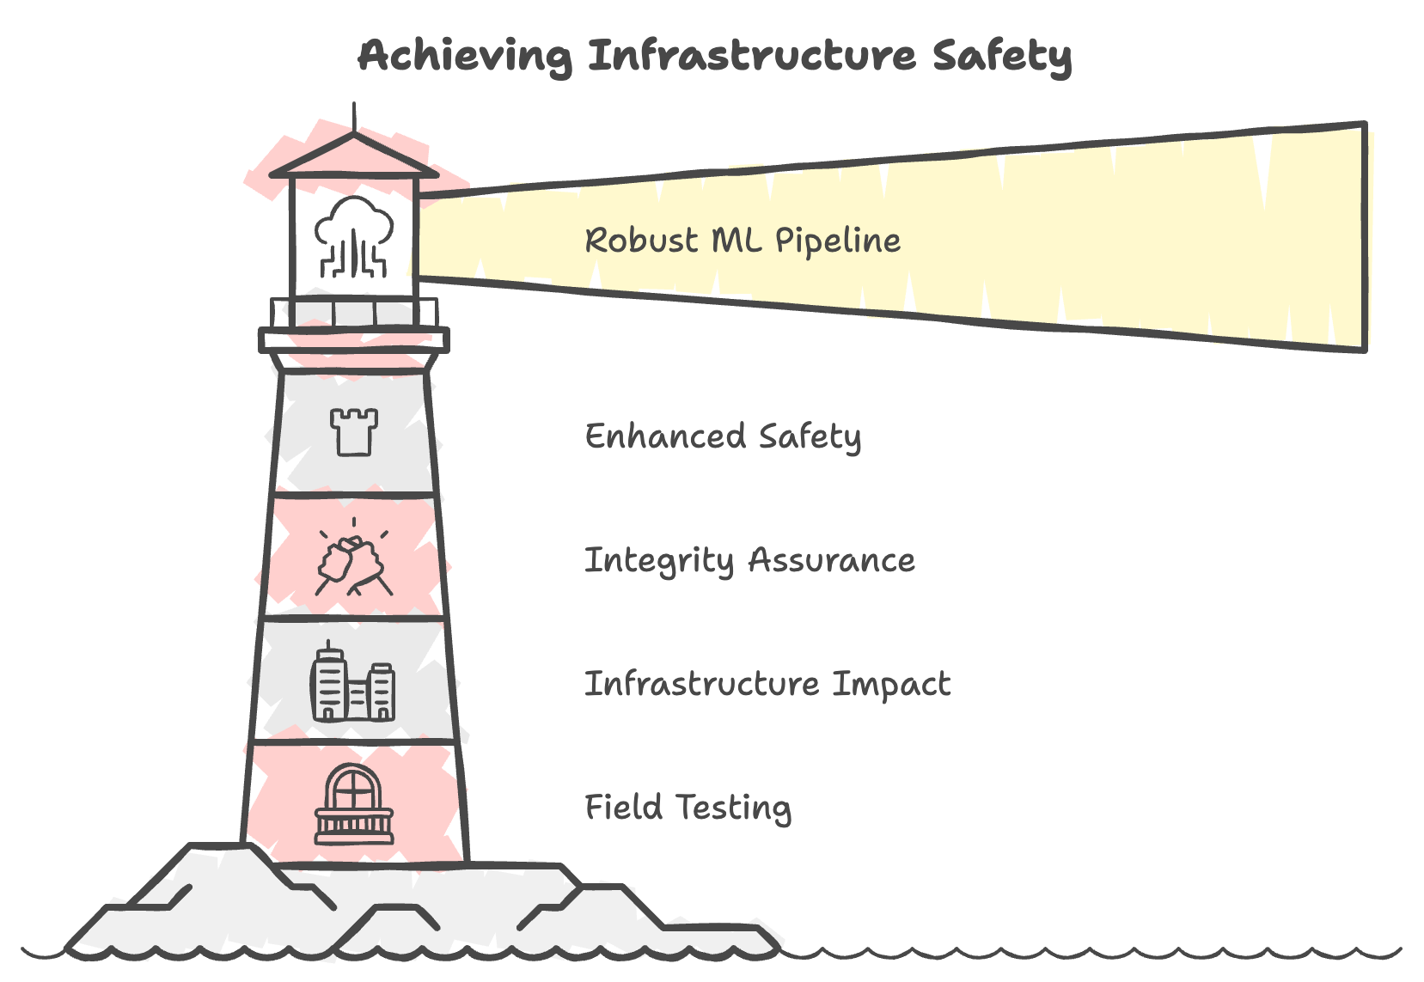
5- Conclusion and future work

